Slide 1
Math & Data
AN introduction into variables and operators

Slide 2
Variables, what are they?
A variable is one of the most powerful features of any programming language
Variables allow us to give named locations that store a value
We can then manipulate variables

Slide 3
Types of variables
There are three main variables that we will be focusing on right now
String
int
double

Slide 4
String
String is a variable type that contains multiple characters
When declaring a String the ‘s’ MUST be capitalized
When you assign values to a String, the text MUST be in double quotes “”

Slide 5
int
int is a primitive data type that can hold whole numbers up to the 32-bit integer limit [-2³¹, 2³¹ -1]
When declaring an int, the ‘i’ must be lowercase
There is another data type called Integer but that is beyond the scope right now
There are also other primitive data type relating to number that are more or less ‘accurate’

Slide 6
double
double is a primitive data type that can hold double-precision 64-bit IEEE 754 floating point
This has no real meaning to us right now and can be boiled down to “double can hold any 64-bit decimal number up to 754 places”
There is another decimal data type that is less accurate, and since memory isn’t an issue, we won’t use it

Slide 7
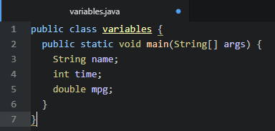
Creating variables
When you create a variable, you must think about what the uses of the variable will be
Naming is also very important
Choose variable names that are meaningful and help convey what the variable is storing

Slide 8
Variables rules
Variables are case sensitive so having a variable named firstName isn’t the same as FirstName
You can’t start your variable with a number or symbol
There are some keywords that you also can’t use as variable names

Slide 9
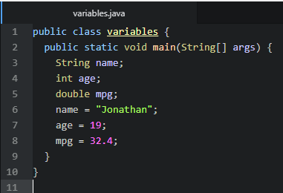
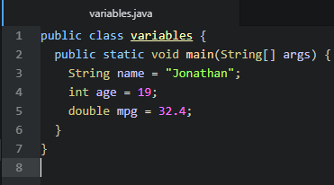
Assigning values to variables
To give a variable a value, we use an assignment statement
Note that the = is assignment and not representing equality
Variables need to be initialized, assigned a value, before they can be used
Alternatively, you can create and set your variables at the same time

Slide 10
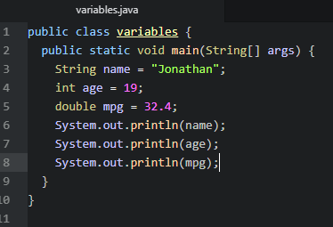

Printing variables
You can now used variables within your print statements to print out what the variable contains

Slide 11
Operators
Like normal, programming has the four basic operations as well
+
-
*
/

Slide 12
More than Math?
While the operators I showed you can do mathematical operations, they can also have another function called concatenation

Slide 13
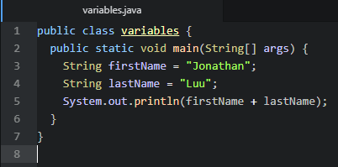

Concatenation
Concatenation is the process of joining one or more strings together

